Slide 1
Maintainability Design II – Part 3 (Structural Design Patterns)
CS 301: IT Solution Architecture
Week 6

Slide 2
Motivation
Problem: Imagine you need to integrate an external (e.g. third party codes) to your existing codes. However, you realize the interfaces are not compatible and you cannot change the external codes. You start to do conditionals but it start to get messy with more external codes that are incompatible.

Slide 3
Adapter

Slide 4
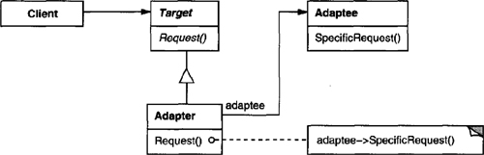
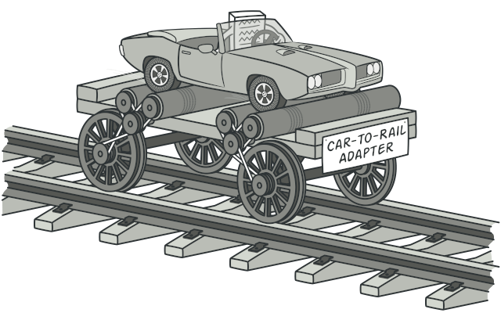
Pattern: Adapter
Intent
Convert the interface of a class into another interface clients expect.
Adapter lets classes work together that couldn't otherwise because of incompatible interfaces.
An object adapter relies on object composition:
Notes:
https://refactoring.guru/design-patterns/adapter
Problem: Sometimes a toolkit class that’s designed for reuse isn’t reusable only because its interface doesn’t match the domain-specific interface an application requires.
Example: Buying off the shelf UI toolkit to replace an existing UI framework. Without changing existing code, this can be done by adapting class interface.
Use the Adapter pattern when
you want to use an existing class, and its interface does not match the one you need.
you want to create a reusable class that cooperates with unrelated or unforeseen classes, that is, classes that don’t necessarily have compatible interfaces.

Slide 5
Let’s assume a claims system
The claims application is meant for staff to login and submit a expense claim.
The expense claims form comprises of the staff personal details and claim items details.
The staff details are stored in centralized MSSQL DB while the claims details are stored in a MySQL DB used only by the claims application.
The expense claim request once submitted, is sent to the appropriate manager/head for approval.
For approved claims, a daily scheduler is configured to invoke the application to send these approved claims to SAP system.
On a monthly basis, staff with managerial role is able to generate claims reports of their staff.

Slide 6
Scenario - Adapter
Scenario : Besides sending to SAP system, you are now required to send to another Csystem developed in C. You are given a C object for your java program. Using Java Native Interface, you are able to wrap the C object and call the C methods from a java program. However, the interfaces of the C object and your existing codes are not compatible.
For example, the SAPService is using send(Claim claim) but the NativeObject is using send(claim.items(), claim.amount)
public class SAPService {
public void send(Claim claim) {
// some preocessing
}
}
// NativeObject with the method differ from
// above send method
//send(claim.items(), claim.amount);
public class OutgoingJob {
public static void main(String[] args) {
SAPService service = new SAPService();
service.send(new Claim());
// For Csystem, possible solution is to use the
// nativeObject and use the incompatible interfaces.
// however this create tight coupling as
// this coder requires to understands the native object.
}
}

Slide 7
Adapter Implementation
“….convert the interface of a class into another interface …”
Create an interface of the adapter.
Create concrete (adapter) class implementing the adapter interface.
Let the adapter compose the adaptee
Implement the logic to adapt the adaptee

Slide 8
Adapter Implementation
interface ClaimAdapterInterface {
public void send(Claim claim);
}
public class CSystemAdapter implements ClaimAdapterInterface {
CSystemService nativeObject =
new CSystemService();
public void send(Claim claim) {
// send claims to C System
nativeObject.send(
claim.getItems(), claim.amount);
}
}
1
public class OutgoingJob {
public static void main(String[] args) {
ClaimAdapterInterface service2 = new CSystemAdapter();
service2.send(new Claim());
}
}
2
4
3
4

Slide 9
Motivation
Problem: Imagine that you must make your set of objects work with external objects (e.g. third party codes). You need to encapsulate some of your objects from external, keep track of dependencies, execute methods in the correct order, and so on.
As a result, the business logic of your classes would become tightly coupled to the implementation details of 3rd-party classes, making it hard to comprehend and maintain.

Slide 10
Facade

Slide 11
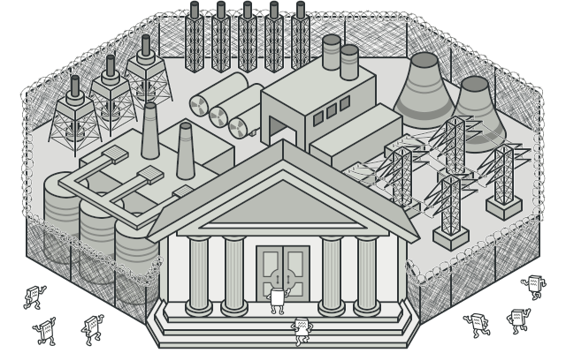
Pattern: Facade
Intent
Provide a unified interface to a set of interfaces in a subsystem. Facade defines a higher-level interface that makes the subsystem easier to use.
Notes:
https://refactoring.guru/design-patterns/facade
Example: In a compiler subsystem, the compiler façade shields the client from the scanner, parser, stream, abstract tree and code generator classes
Structuring a system into subsystems helps reduce complexity. A common design goal is to minimize the communication and dependencies between subsystems.
Use the Facade pattern when
you want to provide a simple interface to a complex subsystem.
there are many dependencies between clients and the implementation classes of an abstraction. Introduce a facade to decouple the subsystem from clients and other subsystems, thereby promoting subsystem independence and portability.
you want to layer your subsystems. Use a facade to define an entry point to each subsystem level. If subsystems are dependent, then you can simplify the dependencies between them by making them communicate with each other solely through their facades.

Slide 12
Let’s assume a claims system
The claims application is meant for staff to login and submit a expense claim.
The expense claims form comprises of the staff personal details and claim items details.
The staff details are stored in centralized MSSQL DB while the claims details are stored in a MySQL DB used only by the claims application.
The expense claim request once submitted, is sent to the appropriate manager/head for approval.
For approved claims, a daily scheduler is configured to invoke the application to send these approved claims to SAP system.
On a monthly basis, staff with managerial role is able to generate claims reports of their staff.

Slide 13
Scenario - Facade
Scenario : In earlier adapter implementation, the claims have to send to both SAP and C system. We need the external scheduler to trigger of the jobs. Daily job is required for SAP system but monthly trigger is only required for SAP. You also understand there might be even more systems to be integrated and do not want to tightly coupled the scheduler with each service.
public class SAPService {
public void send(Claim claim) {
// some preocessing
}
}
public class CSystemAdapter implements ClaimAdapterInterface {
CSystemService nativeObject =
new CSystemService();
public void send(Claim claim) {
// send claims to C System
nativeObject.send(
claim.getItems(), claim.amount);
}
}
public class OutgoingJob {
public static void main(String[] args) {
// Now we need to trigger the right job at the right time.
// ClaimFacadeInterface service = new SAPService();
//service.send(new Claim());
// OR
// ClaimFacadeInterface service2 = new CSystemAdapter();
// service2.send(new Claim());
}
}

Slide 14
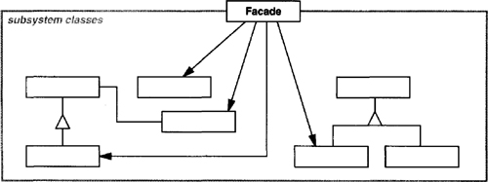
Facade Implementation
“… unified interface to a set of interfaces …”
Create an interface and methods for the set of services behind the facade
Create concrete (service) class implementing the service interface.
Create concrete (facade) class to hide these services
Implement the logic for client to call through the facade

Slide 15
Facade Implementation
interface ClaimFacadeInterface {
public void send(Claim claim);
}
public class SAPService implements ClaimFacadeInterface {
public void send(Claim claim) {
// some preocessing
}
}
public class CSystemAdapter implements ClaimAdapterInterface, ClaimFacadeInterface {
CSystemService nativeObject = new CSystemService();
public void send(Claim claim) {
// send claims to C System
nativeObject.send(claim.getItems(), claim.amount);
}
}
public class OutgoingJobFacade {
public void process(String jobFrequency) {
if (jobFrequency.equals("Monthly")) {
new SAPService().send(new Claim());
} else { // assume daily
new CSystemAdapter().send(new Claim());
}
}
}
1
2
3
2
class OutgoingJob {
public static void main(String[] args) {
String jobFrequency="";
//read from args the jobFrequency
new OutgoingJobFacade().process(jobFrequency);
}
}
4
Notes:
Think along the line of
SOLID
If we have another pattern, do we really want to do that? Remember this is a FAÇADE pattern

Slide 16
Exercise
Structural Design Patterns

Slide 17
Gang of Four (GoF) patterns
Creational Patterns (abstracting the object-instantiation process)
Factory Method Abstract Factory Singleton
Builder Prototype
Structural Patterns (how objects/classes can be combined to form larger structures)
Adapter Bridge Composite
Decorator Facade Flyweight
Proxy
Behavioral Patterns (communication between objects)
Command Interpreter Iterator
Mediator Observer State
Strategy Chain of Responsibility Visitor
Template Method

